Slide 1

Predicting Next Season’s NBA All-Stars From
Last Season’s
Data
by Ian Livingston

Slide 2
Objective
Predict as closely as possible a season’s NBA All-Stars using data available at the end of the previous season
Product:
The 24 most likely Ps
Audience:
Apparel and footwear companies

Slide 3
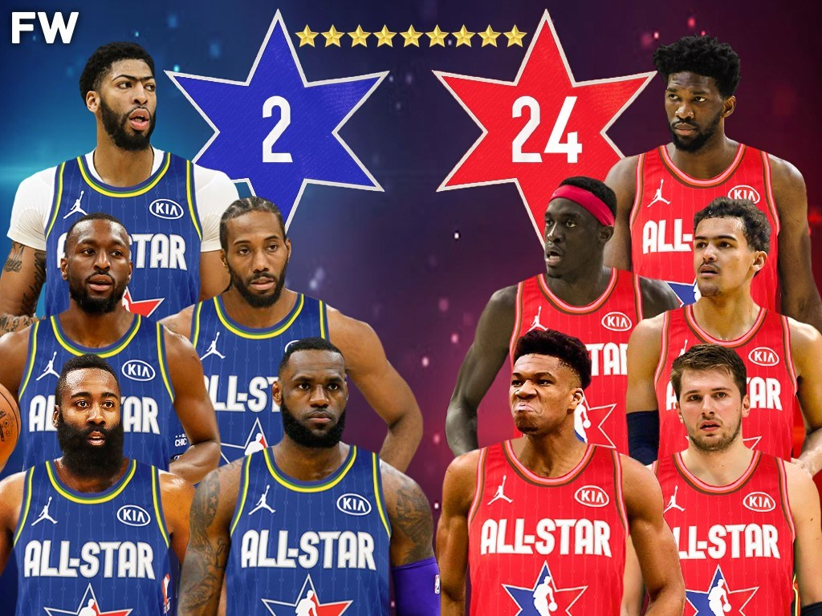

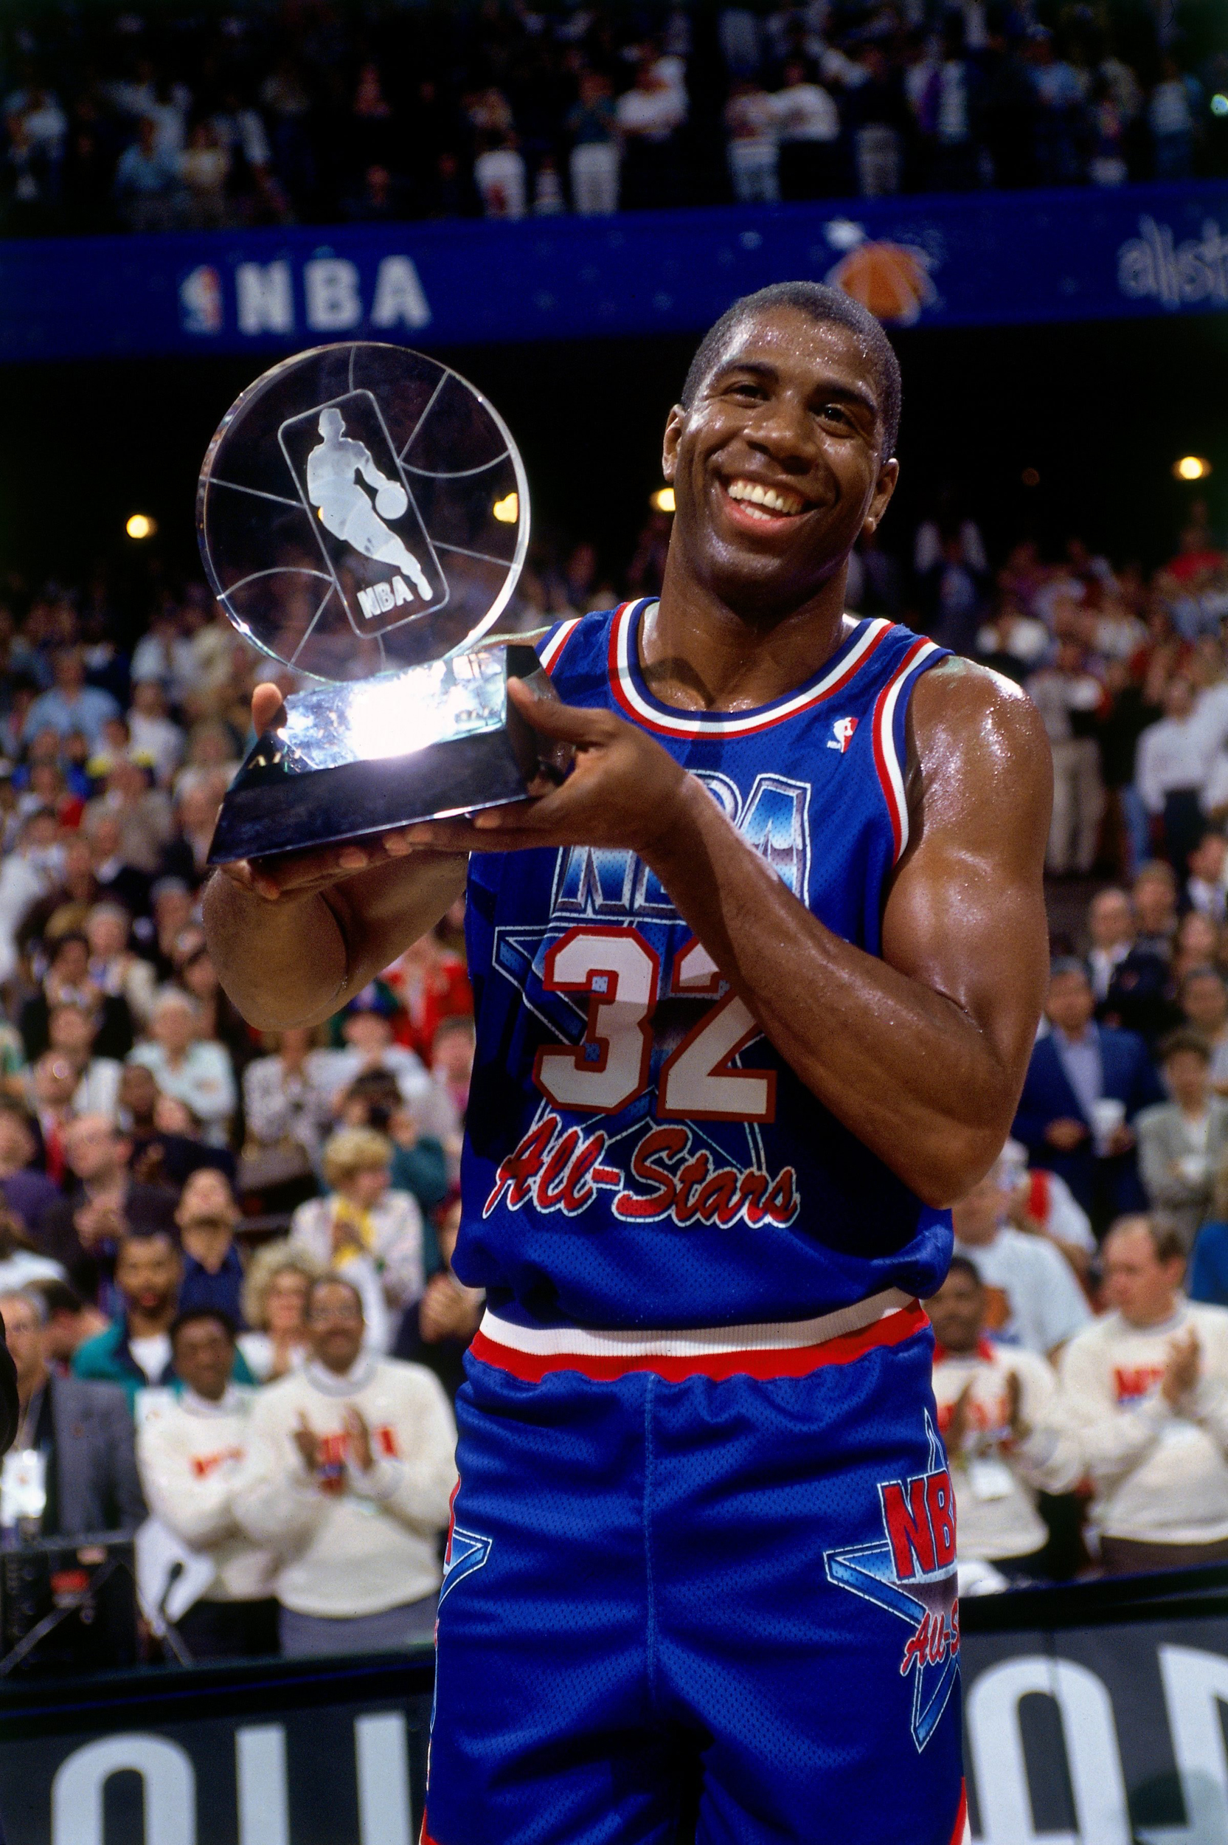
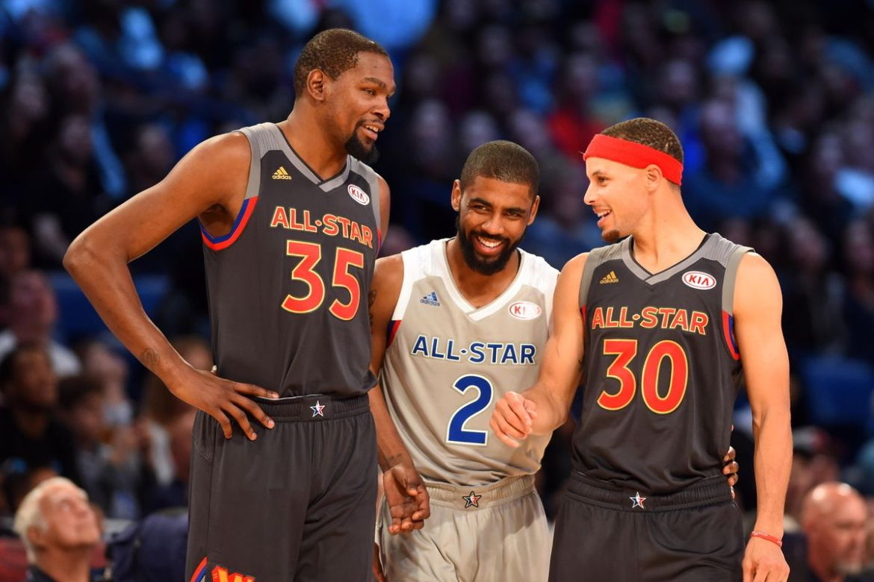
The NBA All-Star Game
Every* year since 1961
24 players every year
Fan voting mostly
$100,000 to winners
Notes:
Changed from 10 to 12 players per conference in 1973
A few changes in selection process

Slide 4

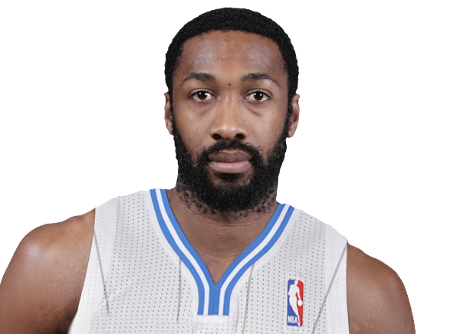
What makes an NBA All-Star?
“
I mean, some people wanted Jose Calderon. Jose Calderon? Who? Come on man, this is All-Star, people. When I’ve seen some of the names that are being thrown around on the ticker as snubs, it’s killing me. I understand Calderon has the best assist-turnover ratio in the league, but you know what’s funny? All back-up point guards have the best assist-turnover ratios. Screw it, Kevin Ollie should be an All-Star then! For like five or six years, Ollie was No. 1 in assist-turnover ratio!
- Gilbert Arenas, 2008
”
Notes:
Jose Calderon had best AST/TO ratio and a PER over 20

Slide 5







Tools/data

Slide 6
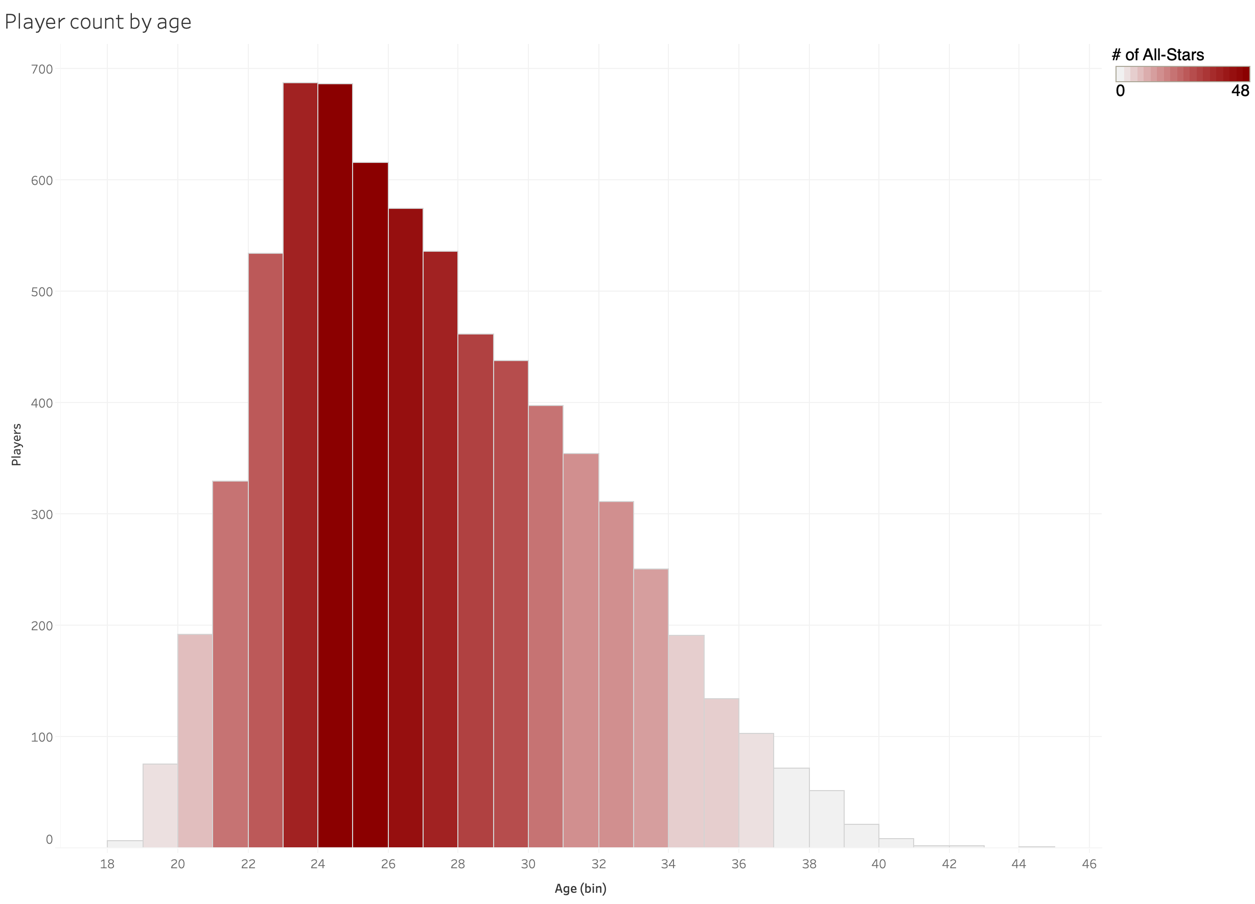
Early process
Average age
of All-Stars
26.4
~7,500 rows
~400 All-Stars
1999-00 to 2015-16
A lot of noise at the bottom
Some counting stats like def stats didn’t offer much
Some advanced stats like WS didn’t offer much
Average age of NBA players
26.8
Notes:
After a ton of data cleaning (some guys with the same name like Chris Johnson and Marcus Williams, Metta World Peace
Average age of All-Star (26.4) right around average age of player
A little more centered, though

Slide 7
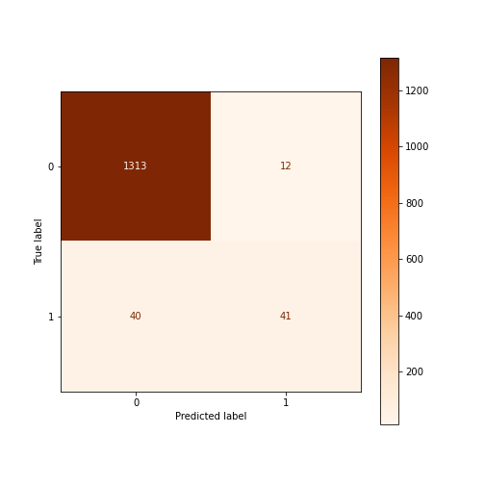

First confusion matrices
KNN (k=5)
Logistic regression
Notes:
Logistic and KNN with total points, total assists and PER
Focus was accuracy, with emphasis on precision over recall

Slide 8
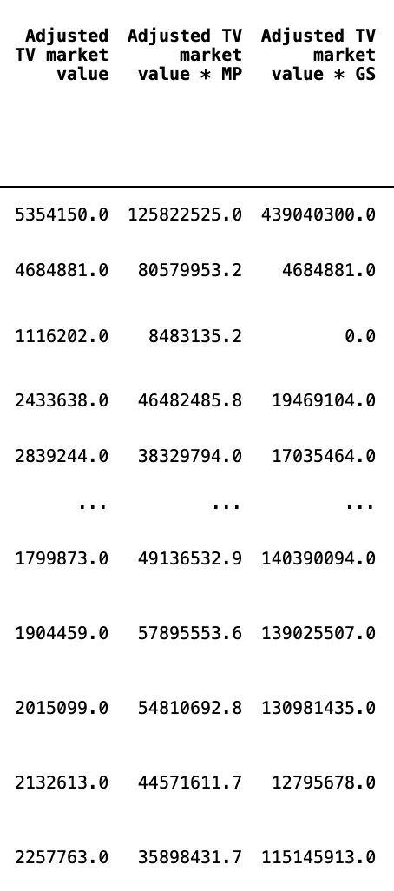
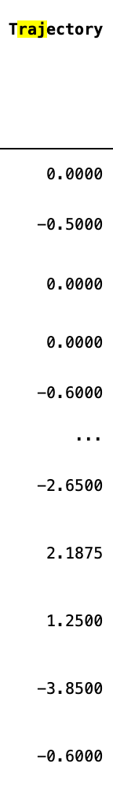
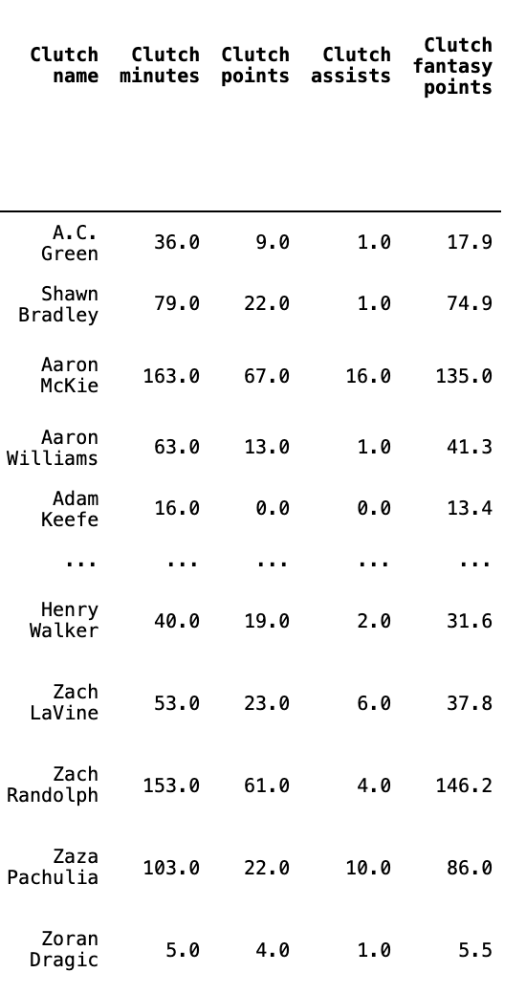
Feature engineering
Trajectory
Clutch stats
Adjusted TV market value
Notes:
With such imbalance and a few major stats doing a lot of work I turned by focus to scraping new data and feature engineering

Slide 9
Final model
Features (11)
★ All-Star? ★ PTS/game ★ AST/game ★ Years from prime ★ PER ★ Trajectory ★ Adj. TV mkt. value * GS ★ TRB/game ★ PTS+AST/game ★ MP/game ★ FT/game ★
Ensemble
★ LogisticRegression ★ KNN (k=9) ★ RandomForest (max_depth=6, min_samples_splits=9) ★
SVC ★
Acc: 97% ★ Pre: 81% ★ Rec: 54%

Slide 10
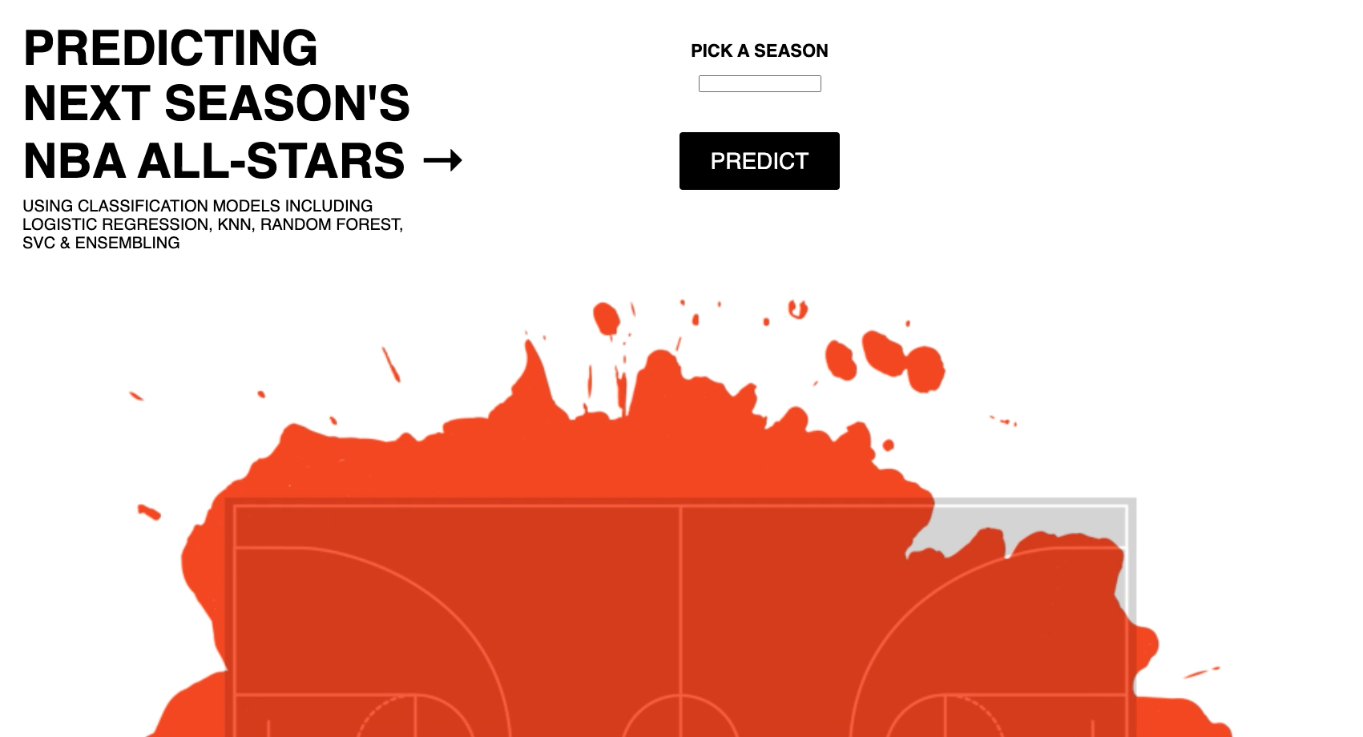
Via Flask

Slide 11
References
stats.NBA.com
basketball-reference.com
"NBA Players stats since 1950,” Omri Goldstein, https://www.kaggle.com/drgilermo/nba-players-stats
“NIELSEN DMA RANKINGS,” Sports Business Daily, https://www.sportsbusinessdaily.com/Daily/Issues/2001/08/14/Ratings-Research/NIELSEN-DMA-RANKINGS.aspx
“NBA All Star Game 2000-2016,” Felix Mejia, https://www.kaggle.com/fmejia21/nba-all-star-game-20002016
Mahoney, Rob, "What Makes an N.B.A. All-Star?,” https://offthedribble.blogs.nytimes.com/2010/12/09/what-makes-an-n-b-a-all-star

